Slide 1
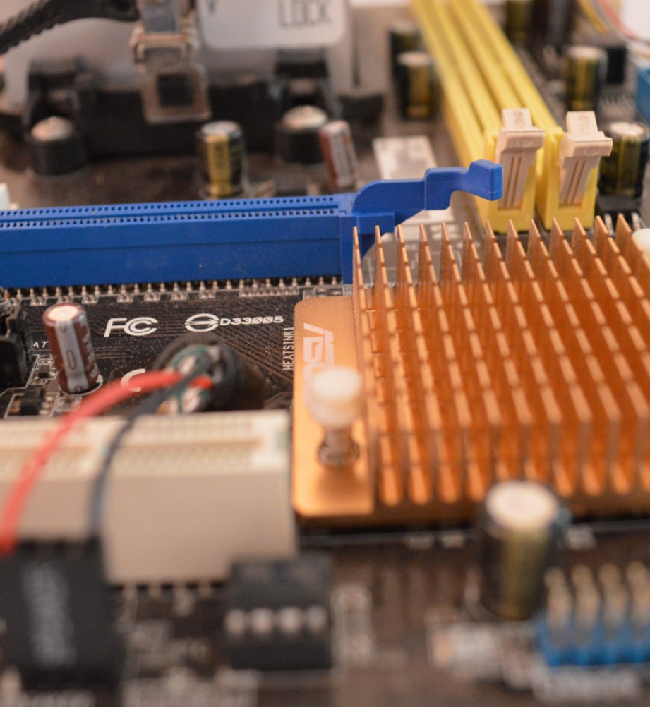
Computer Science
Transition workbook
The course is assessed by
2 exams (50% each exam)
The topic of Computer Science is at the heart of the modern world
Studying it can make you extremely sought after in todays job market
The transition from GCSE to A level is significant, this includes:
  An increased emphasis on technical content
  An increased emphasis independent research
This workbook is designed to allow you to practice some of these skills and build on your existing knowledge.
Please complete by your first lesson back in September.

Slide 2
1
“Tell me about yourself”
Why did you choose Computer Science?
Expected time to complete: ½ hour
In this simple task you get the opportunity to tell me your choices and reasons behind choosing to study Computer Science. Please answer all questions as best you can.
1. Why did you choose to study A level Computer Science?
2. What other courses have you chosen to study at Key Stage 5, and what made you choose this combination?
3. What are you hoping to achieve from studying Computer Science?
4. How would you describe yourself as a learner at GCSE? What skills where you good at, what areas would you like to improve on?
5. What are your other hobbies and interests outside of school? Anything related to Computing?

Slide 3
2
Independent research task
Emerging computer technology
Expected time to complete: 2 hours
In this task you get to investigate any area of emerging computer technology which interests you.
You can pick any area which interests you, but examples could be:
Artificial intelligence
Robotics
Automated self driving cars
Quantum computing
In no more than ONE side of A4 summarise the area you have chosen under the following four headings:
What is it?
What are the possible Social, Moral, Cultural and Ethical benefits of this technology on society
What are the possible Social, Moral, Cultural and Ethical risks of this technology on society
My conclusion on this technology and what it will mean for our world 10 years from now
Additional help:
For additional help and support in structuring your answer you might like to watch some of the videos from the following Craig ‘n’ Dave playlists:
OCR:
SLR 17 – Ethical, morale and cultural issues
https://student.craigndave.org/videos/slr-17-ethical-moral-and-cultural-issues

Slide 4
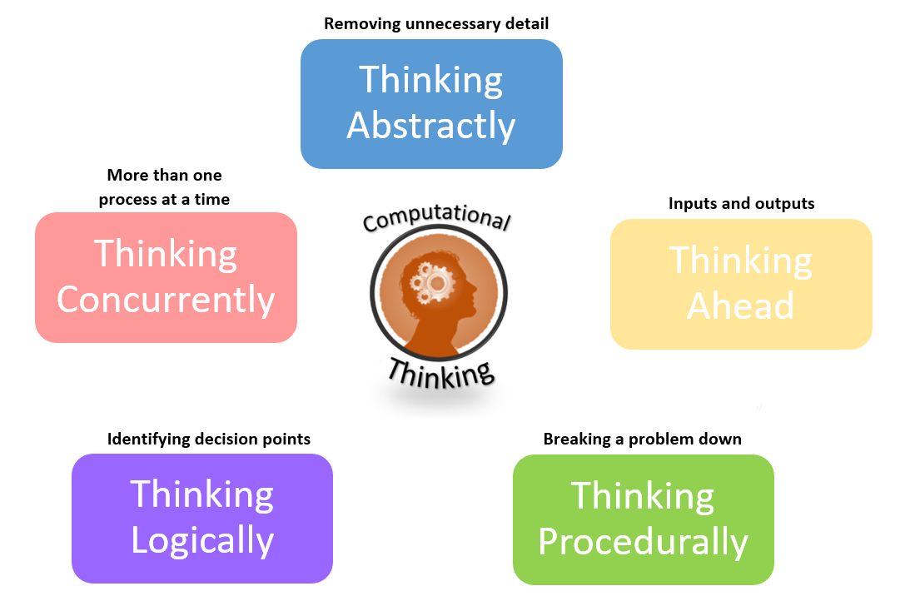
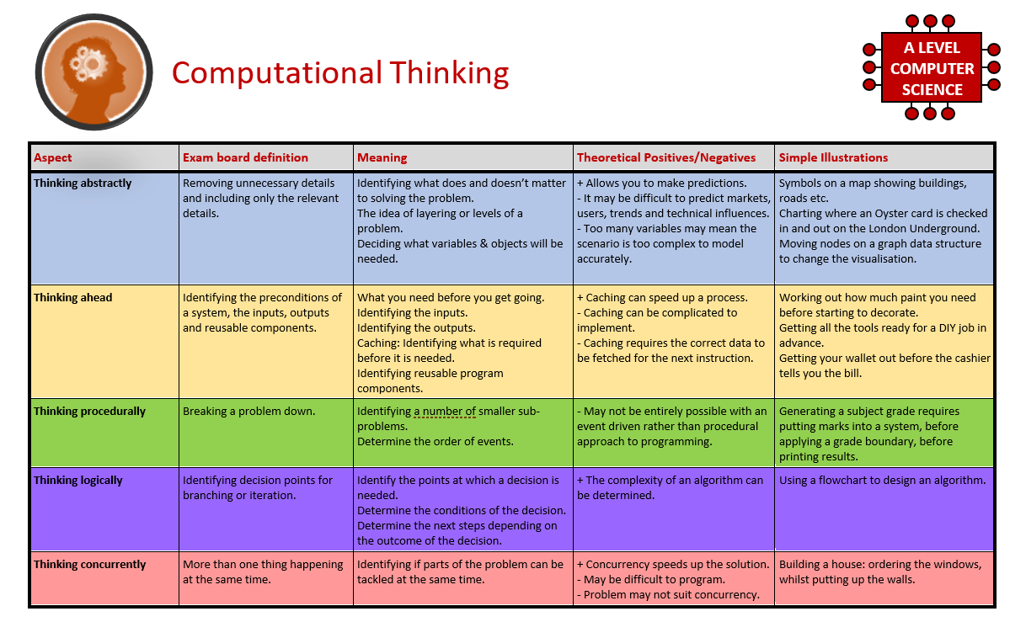
3
What is “computational thinking”?
Thinking like a computer
Expected time to complete: 2 hours
At the heart of Computer Science is the ability to look at problems, analyse them, break them down and solve them in a way which involves a variety of “Computational Thinking” skills.
Download the “Computational thinking and Computational methods placemats” from Craig n Dave:
  https://student.craigndave.org/specification-key-terminology-and-cheat-sheets
Create your own spider diagram / mind map which shows your clear understanding of the 5 different computational thinking strands
  Keep it to a single side of A4 / A3
Your goal is to imagine someone else has to revise from your mind map. Ask yourself:
  Does it make sense?
  Is it clear?
  Does it cover all of the important concepts?

Slide 5
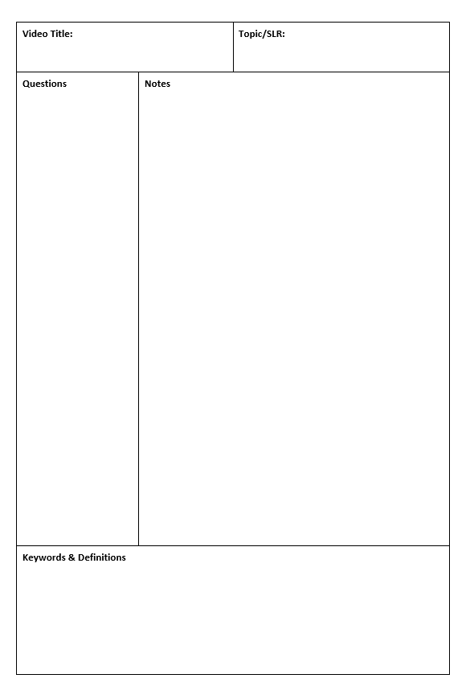
4
Note taking practice task
The Cornell method of note taking
Expected time to complete: 1½ hours
The expectation to do independent research at A Level will increase dramatically from GCSE.
There is a real skill to taking decent notes outside of lesson which are of value. Research has proven that one of the most effective methods is the “Cornell” note taking method.
To start download the “Cornell note taking template” from Craig n Dave:
  https://craigndave.org/product/cornell-note-taking-template/
Pick any two of the following videos from Craig ‘n’ Dave:
  OCR: https://student.craigndave.org/videos/ocr-alevel-slr01-alu-cu-registers-and-buses
  OCR: https://student.craigndave.org/videos/ocr-alevel-slr04-paging-segmentation-and-virtual-memory
  OCR: https://student.craigndave.org/videos/ocr-alevel-slr05-stages-of-compilation
  OCR: https://student.craigndave.org/videos/ocr-alevel-slr14-data-structures-part-2-graphs
Write the title of the video and its topic in the top boxes (use a different sheet for each video).
In the main “Notes” section, write notes from the video. You can do this in any way you like, a suggestion might be to rewind slightly when the canvas changes, thinking carefully about what was important in the previous few minutes.
Having recorded the notes, review them:
  Turn each part into a question in the section on the left.
  For example, the notes may say, “The value of the program counter is passed to the memory address register”.
  The question then becomes, “which register is the value of the program counter passed to?”
  Sometimes these questions are easy, and at times they are more difficult to write.
  There may also be more than one valid question.
  You will need to decide for yourself which are the most appropriate questions for revision.
Finally pull out all the key words and their definitions words the notes and list them in the bottom section.

Slide 6
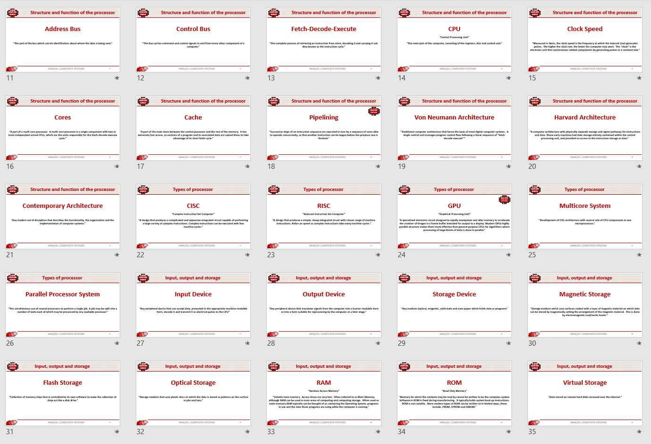
5
Key terms task
Getting to grips with terminology
Expected time to complete: 2 hours
An important aspect of being successful with your study of Computer Science is getting to grips with subject related terminology. There are over 240 specific terms you will need to learn!
Below are a handful of the key terms you will need to become familiar with.
Control Unit Register Busses
Von Neuman Architecture Optical Storage Operating System
Intermediate Code Device Driver Compiler
Assembly Language Machine Code Lossy Compression
Hashing Normalisation TCP/IP Stack
Packet Switching ASCII Problem Decomposition
Research each of the key terms and write a definition.
Resist the urge to simply cut and paste a definition from the first website you find.
Many definitions found on The Internet are overly complicated and wordy.
Ask yourself:
  Does my definition make sense?
  Is it succinct, to the point?
  Does the definition have appropriate depth and detail for A’Level?
  Could I give this definition to another student so they could revise from it?

Slide 7

6
An introduction to the basics of programming tasks
Programming basics
Expected time to complete: 6 hours
Learning to “code” is a fun and essential part of A Level Computer Science. At A-Level you will learn two additional programming languages.
Head over to the web site: https://www.w3schools.com/cs/index.php
Complete the following C# tutorials under the heading:
  C# HOME
  C# Intro
  C# Get Started
  C# Syntax
  C# Output
  C# Comments
  C# Variables
  C# Data Types
  C# Type Casting
  C# User Input
  C# Operators
  C# Math
  C# Strings
  C# Booleans
  C# If...Else
  C# Switch
  C# While Loop
  C# For Loop
  C# Break/Continue
  C# Arrays
Each section presents you with theory, code to run and exercises to try out.
You can use Repl.it to practice writing your own C# programs

Slide 8
7
Critical thinking task
Why is Computer Science important?
Expected time to complete: 2 hours
It is easy to say, “Computer Science is essential in todays world”, but are you able to think critically about this statement and back it up? “Thinking Critically” is an essential skill at A Level.
It involves you:
Looking at a topic / concept in depth
Taking account of different views / perspectives
Considering positives and negatives
Evaluating links and effects on other concepts
Drawing your own conclusions backed up with evidence
On the following slide answer the questions:
  What is Computer Science?
  What are the benefits and risks of Computer Science at a local level (think about your local community / town / city / county)
  What are the benefits and risks of Computer Science at a national level
  What are the benefits and risks of Computer Science at a global level
Additional help:
For additional help and support in structuring your answer you might like to watch the following videos from the following Craig ‘n’ Dave playlist:
OCR:
SLR 17 – Ethical, morale and cultural issues
https://student.craigndave.org/videos/slr-17-ethical-moral-and-cultural-issues

Slide 9
7
Critical thinking task
Why is Computer Science important?
Expected time to complete: 2 hours
  Enter your answer here
What is Computer Science?
  Enter your answer here
  Try to make at least 4 valid points
  At least 2 of your points should be about the potential risks of Computer Science
  At least 2 of your points should be about the potential benefits of Computer Science
What are the benefits and risks of Computer Science at a local level
  Enter your answer here
  Try to make at least 4 valid points
  At least 2 of your points should be about the potential risks of Computer Science
  At least 2 of your points should be about the potential benefits of Computer Science
What are the benefits and risks of Computer Science at a national level
  Enter your answer here
  Try to make at least 4 valid points
  At least 2 of your points should be about the potential risks of Computer Science
  At least 2 of your points should be about the potential benefits of Computer Science
What are the benefits and risks of Computer Science at a global level

Slide 10
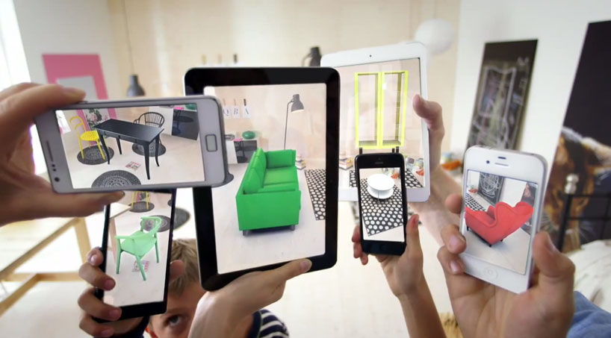
8
Applying technical knowledge in context task
Augmented reality
Expected time to complete: 1½ hours
A key skill at A Level is being able to take a topic and then discuss it in the context of different scenarios.
Most theory-based exam questions will be asked in the form of a scenario, simply regurgitating what you know on the topic without contextualising your answer to the scenario will often result in low marks!
The topic for this exercise is “Augmented Reality”. It is a truly fascinating area of technology which has the potential to change almost every aspect of our daily lives.
Watch this brief video to learn more: https://www.youtube.com/watch?v=vQtwWzfzKXI
After watching the video complete the next slide which asks you to discuss the benefits, limitations and risks of augmented reality in the context of:
Medicine & health care
Gaming & entertainment
Schools & learning
Travel & tourism
Social media
Transport & navigation
Image by Oyundari Zorigtbaatar (20 March 2016) https://creativecommons.org/licenses/by-sa/4.0/legalcode

Slide 11
8
Applying technical knowledge in context task
Augmented reality
Expected time to complete: 1½ hours
Medicine & health care
Discuss the benefits, limitations and risks of augmented reality in this context:
  Enter your answer here
Gaming & entertainment
Discuss the benefits, limitations and risks of augmented reality in this context:
  Enter your answer here
Schools & learning
Discuss the benefits, limitations and risks of augmented reality in this context:
  Enter your answer here
Travel & tourism
Discuss the benefits, limitations and risks of augmented reality in this context:
  Enter your answer here
Social media
Discuss the benefits, limitations and risks of augmented reality in this context:
  Enter your answer here
Transport & navigation
Discuss the benefits, limitations and risks of augmented reality in this context:
  Enter your answer here

Slide 12
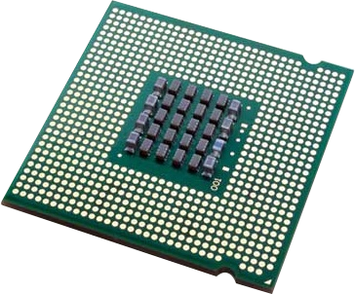
9
Systems architecture task
Looking under the hood of the processor
Expected time to complete: 2 hours
The CPU “Central Processing Unit” is the central core of any computer system. You will study what it contains and how it works it in depth at A Level.
Start by watching the following 3 videos from Craig ‘n’ Dave
  OCR: https://student.craigndave.org/videos/ocr-alevel-slr01-alu-cu-registers-and-buses
  OCR: https://student.craigndave.org/videos/ocr-alevel-slr01-fetch-decode-execute-cycle
  OCR: https://student.craigndave.org/videos/ocr-alevel-slr01-performance-of-the-cpu
Produce a fully annotated diagram on a single sheet of A4 / A3 paper which shows how the CPU works.
Make sure the diagram includes and covers:
  Major CPU components and what they are for:
    Arithmetic Logic Unit (ALU)
    Control Unit (CU)
    Cache
  The main registers
    Program Counter (PC)
    Memory Address Register (MAR)
    Current Instruction Register (CIR)
    Memory Data/Buffer Register (MDR / MBR)
  Fetch-decode-execute cycle
  Include annotations which explain how the performance of a CPU can be improved by:
    Increasing the clock speed
    Increasing the cache size
    Increasing the number of cores

Slide 13
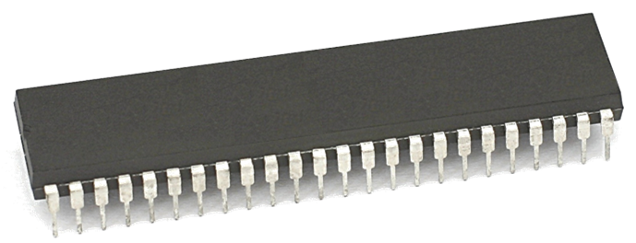
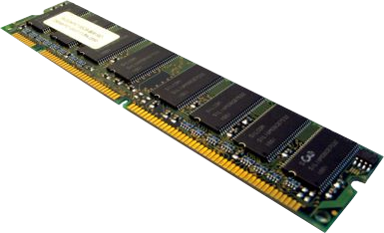
10
Memory task
Different types of memory
Expected time to complete: 1 hour
Computer memory comes in many different forms, some of the main ones are:
Random Access Memory (RAM)
Read Only Memory (ROM)
Virtual Memory
Carry out some research into these forms of memory and then complete the tasks on the following slide.
Additional help:
For additional help and support in completing this task you might like to watch some of the following videos from Craig ‘n’ Dave:
RAM and ROM:
https://student.craigndave.org/videos/ocr-gcse-slr1-2-ram-and-rom
The need for Virtual Memory:
https://student.craigndave.org/videos/ocr-gcse-slr1-2-the-need-for-virtual-memory

Slide 14
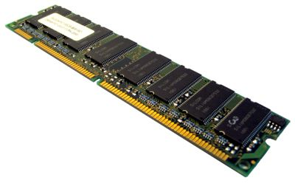
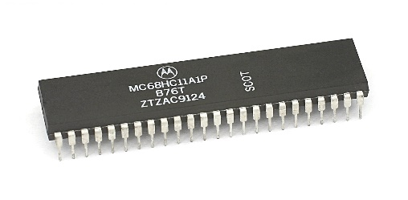
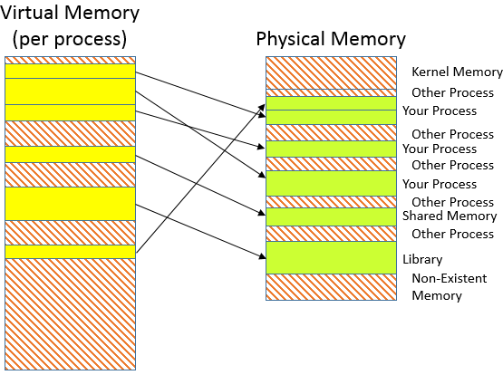
10
Memory task
Different types of memory
Expected time to complete: 1 hour
  <Enter a definition for RAM>
  <State if RAM is volatile or non volatile>
  <State if RAM is read only or read & writeable>
  <Describe what sort of information RAM typically holds>
  <Enter a definition for ROM>
  <State if ROM is volatile or non volatile>
  <State if ROM is read only or read & writeable>
  <Describe what sort of information ROM typically holds>
  <Enter a definition for Virtual Memory>
  <Explain why virtual memory is needed>
Random Access Memory (RAM)
Read Only Memory (ROM)
Virtual Memory

Slide 15

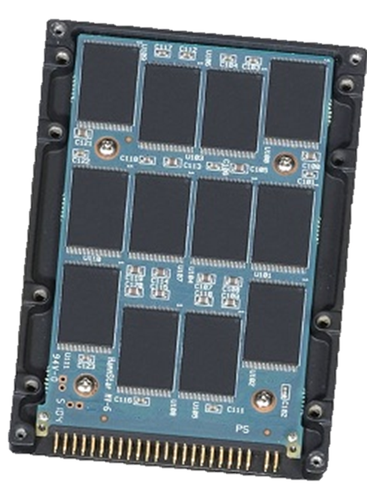

11
Storage task
Types of secondary storage
Expected time to complete: 1 hour
Virtually all secondary storage devices in use today fit into one of three broad categories:
Magnetic
Optical
Solid state
Carry out some research into these categories and then complete the tasks on the following slide.
Additional help:
For additional help and support in completing this task you might like to watch some of the following videos from Craig ‘n’ Dave:
Magnetic, Flash and Optical storage:
https://student.craigndave.org/videos/ocr-alevel-slr03-magnetic-flash-and-optical-storage
Comparing capacity and speed of storage media:
https://student.craigndave.org/videos/aqa-alevel-slr18-comparing-capacity-and-speed-of-storage-media

Slide 16
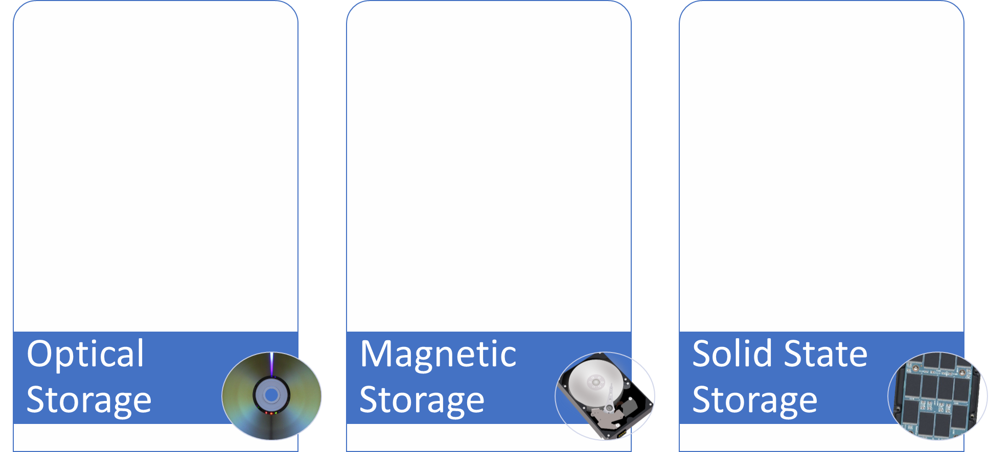
11
Storage task
Types of secondary storage
Expected time to complete: 1 hour
How does it work?
How does it work?
How does it work?
Enter your answer here…
Enter your answer here…
Enter your answer here…
Advantages / Positives
Advantages / Positives
Advantages / Positives
Enter your answer here…
Enter your answer here…
Enter your answer here…
Disadvantages / Negatives
Disadvantages / Negatives
Disadvantages / Negatives
Enter your answer here…
Enter your answer here…
Enter your answer here…
Examples of typical usage
Examples of typical usage
Examples of typical usage
Enter your answer here…
Enter your answer here…
Enter your answer here…
Typical storage capacity range
Typical storage capacity range
Typical storage capacity range
Enter your answer here…
Enter your answer here…
Enter your answer here…

Slide 17










12
Networks task
Types of networks
Expected time to complete: 2 hours
Use the following symbols:
Carry out some research on computer networks, in particular LANs, WiFi, Network topologies and connectivity devices.
Use the symbols on the right to create an appropriate network over the floorplan on the next slide.
Make sure your network meets all the following requirements:
Each member of the main office needs a desktop PC
Angela, Pam, Dwight and Oscar also use an office issued smart phone
The following rooms new access to WiFi:
  Meeting room (top right)
  Reception
  Conference Room
  Main office
Use a circle with a transparent fill (so you can see the network underneath) with a width and height of 12.5cm to provide the WiFi coverage needed to cover the rooms above:
  The circles need to have a WAP at the centre
  The 12.5cm diameter circles represent the maximum range of each WAP
  They WAP icons must be attached to a wall
  You must use the minimum number of WAP possible to provide the coverage needed
All desktop PCs use wired connections in a star network configuration
  The top left server room, conference room and main office need to be on one subnet with its own switch
  All other rooms are on a separate subnet and will require its own hardware for this
  The two subnets need to be appropriately connected together
The top left room needs to have a server placed in it and connected appropriately to the local subnet
The server room needs hardware to appropriately connected the LAN to “The Internet”
Reception needs a photocopier and it needs connecting to the local subnet
A firewall should be placed somewhere appropriate
Desktop PC
Tablet
Phone
Router
WAP
Switch
Firewall
Server
Photocopier
Indicates a wireless enabled device
Additional help:
For additional help and support in structuring your answer you might like to watch some of the videos from the following Craig ‘n’ Dave playlists:
OCR: SLR 11 – Networks
https://student.craigndave.org/videos/slr-11-networks

Slide 18
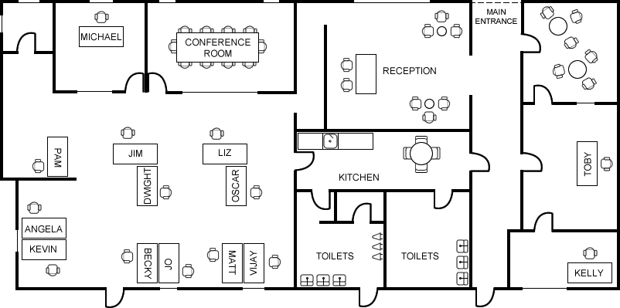
12
Networks task
Types of networks
Expected time to complete: 2 hours

